Slide 1


Final Project by: Zvi Amosi and Alexey Serdtse
Big Data Engineering

Slide 2


Authors
Zvi Amosi
BI Developer and Analyst Ayalon Insurance Company Ltd.
Alexey Serdtse
ETL Developer Naya Technologies (Nice Ltd.)

Slide 3
A large retail network is required to publish product prices within an hour of updates.
The published data includes: prices, promotions, chain name, branch, date and time.
At the end of each day, the data is deleted, and no historical record is kept.
Currently, at least two apps utilize this data.
No one tracks or displays historical changes over time.
Background

Slide 4
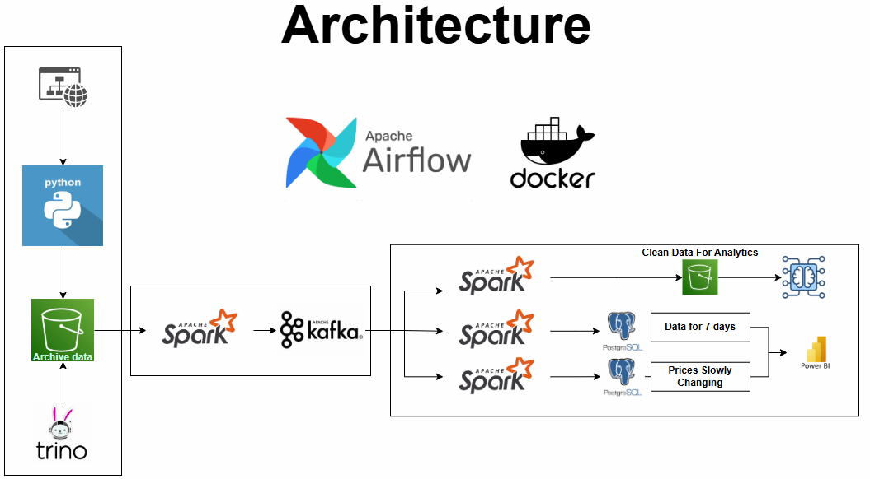

Slide 5
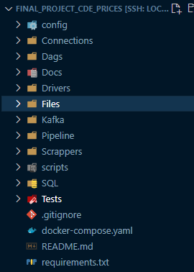
Project Structure
Configuration file – Configuration files that hold connection params: secrets/access keys, bootstrap servers, and other environment-specific configurations.
Connections – Reusable functions and utilities for establishing connections to external services i.e. databases, buckets etc.
DAGS - Definitions for orchestrating workflows.
Drivers - Drivers required for interacting with external tools.
Kafka – Include files tracking Kafka’s offsets for each producer.
Pipeline – The core pipeline logic for processing, transforming, and loading data.
Scrapper - Script for web scraping and extracting data from external website.
Tests – Testing validity and existence of components required to correct run of code.
Requirements - Lists Python dependencies required for the project, which can be installed using “pip install –r “

Slide 6
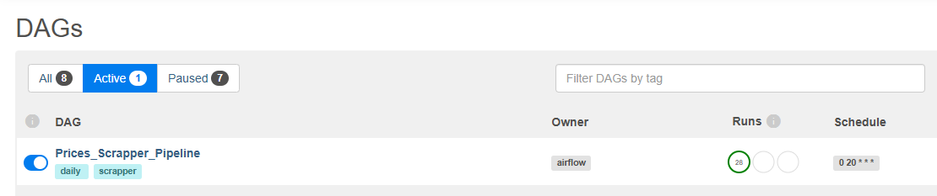
Central DAG
Prices_Scrapper_Pipeline: runs daily in 10 PM Israel (8 PM UTC)

Slide 7
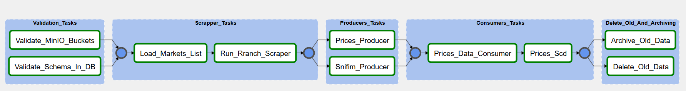
DAG’s expand
Validation Tasks:
Verify that all mandatory buckets required for the pipeline exist and are available (using the MinIO Client).
Ensure that all mandatory tables for the pipeline exist and are available (using SQLAlchemy Inspect).
Consumer Tasks:
Processes Kafka messages, enriches and cleans the data using Spark. Stores results in PostgreSQL and MinIO.
Process Kafka’s messages and generates a table with data of “slowly changes dimensions”.
Scrapper tasks
Load list of markets with access credential to access data from source system.
Automates the extraction, parsing, and storage of XML data files from a secured website into MinIO storage as parquet files.
Delete and Archiving:
Archives and deletes files older than a specified threshold (7 days) in a MinIO bucket
Deletes outdated data from a PostgreSQL table based on a defined threshold

Slide 8
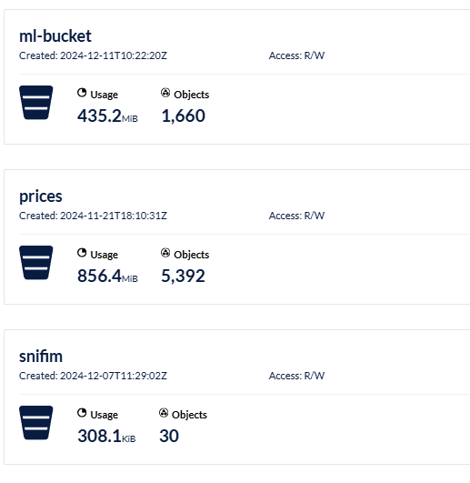
List of Buckets

Slide 9
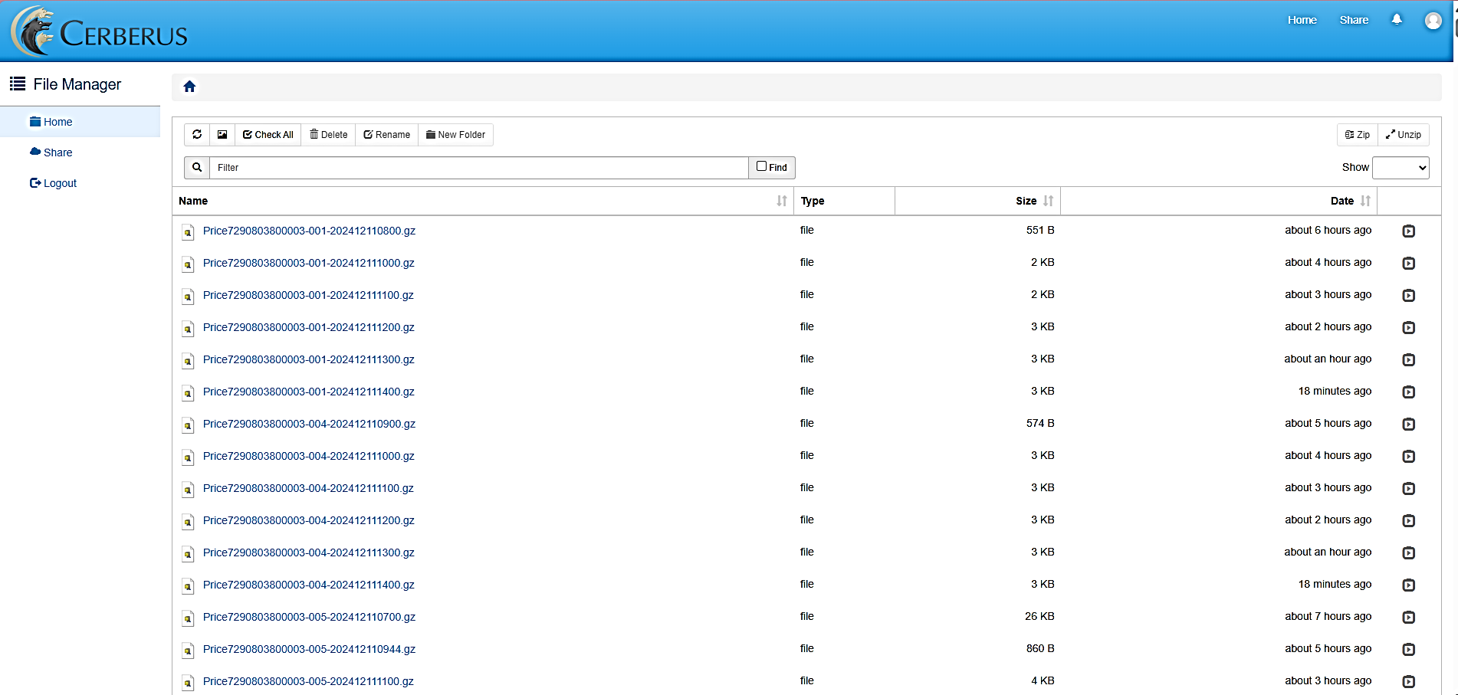
Source Of Data
URL: https://url.publishedprices.co.il/file/d/ Username: yohananof

Slide 10
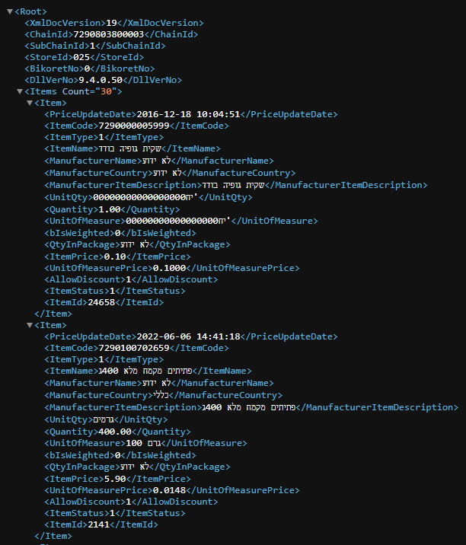
Source Of Data
XML File inside every zip file

Slide 11
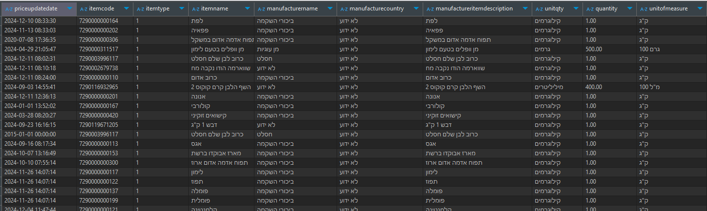
Import Data To Archive Buckets
Scraping Mechanism:
A scrapper iterates over all providers and branch daily data. Using BS4, Selenium and Chrome web driver.
Extracts pricing data and stores it in a “prices” bucket. Only new files!
Data Format:
Data is saved in Parquet files with Snappy compression for efficient storage and retrieval.
Orchestration:
Automated with Airflow, ensuring a scheduled daily run.

Slide 12
Pipeline: Prices Data Consumer
Pipeline applies a series of transformations to enrich, clean, and derive insights from raw Kafka data.
Stages:
Read data from Kafka’s producers.
Read data from “dim” data from MinIO bucket and Postgres table
Broadcast join for data frame enrichment.
Filter on mandatory columns.
Add calculated columns (for example days since last price change).
Set default values.
Returns data to MinIO bucket and Postgres table in “DWH” schema

Slide 13
Pipeline: Archive and delete old data
This process automates the clean up of outdated PostgreSQL records and archives old files in MinIO, optimizing storage and streamlining workflows for greater efficiency.
Automated PostgreSQL Record Deletion Flowchart:
Connect to the Database → Identify Outdated Rows → Execute Deletion Query → Log Results → Close Connection
Automated Old data archiving – key components:
get_objects_older_than: Identifies and returns a list of files in the bucket that are older than the specified threshold.
update_zip_archive: Updates an existing archive (or creates a new one), appending old files from the bucket and uploading the updated archive.
archive_and_delete_files: Orchestrates the archiving process by identifying old files, adding them to the archive, and deleting them from the bucket.

Slide 14
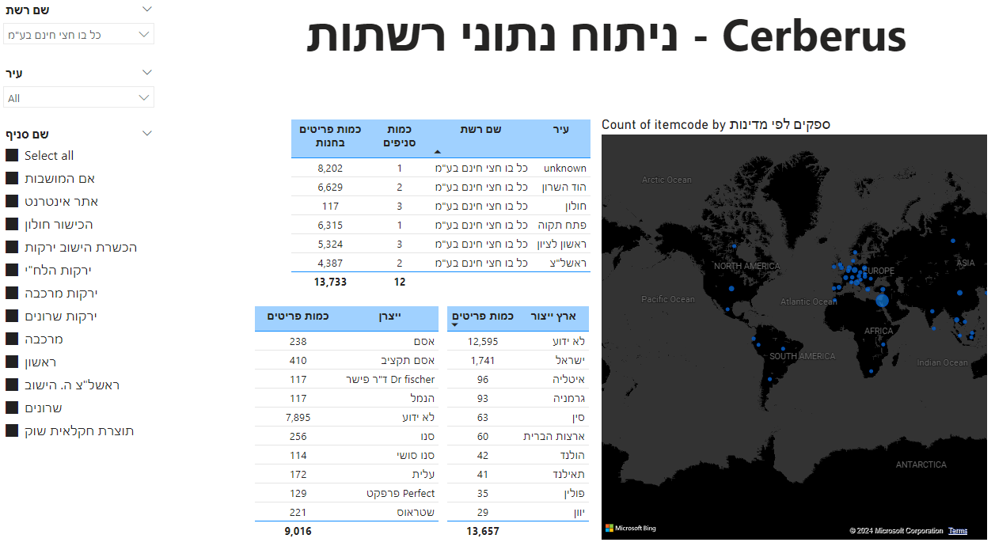

Slide 15

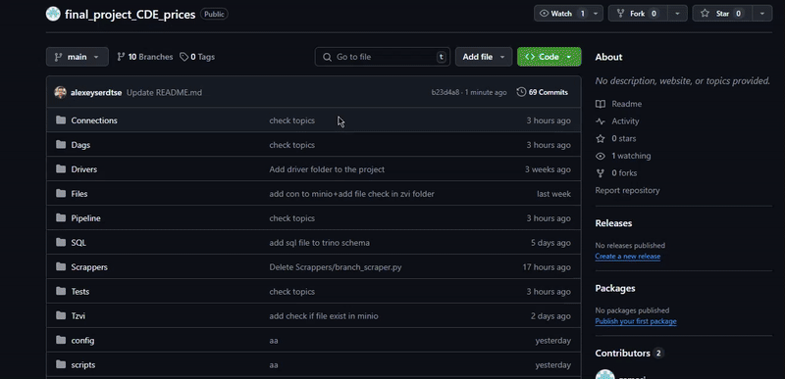

Github Repository
Link to repository: https://github.com/zamosi/final_project_CDE_prices

Slide 16


